Slide 1

PCIe
By vennapusa sravanthi
Chipweave technologies pvt lmd

Slide 2
CONTENTS
Introduction
PCIe PHY Layer
Partitioning PHY Layer for PCIe
Short Reach(SR) Applications
Configurable Pairs
PHY/MAC Interface
PHY/MAC Interface
PCLK rates and Data Widths
PCIe Functionality
PHY Functional block diagrams
Original PIPE Architecture
SerDes Architecture

Slide 3
Introduction
PIPE stands for PHY Interface for PCI Express.
PCIe Stands for Peripheral Component Interconnect Express.
PCIe Physical Layer
The PCIe PHY layer handles the low level PCIe protocol and signaling.
It defines a standard interface between a PHY and a Media Access Layer (MAC) and a Link Layer ASIC
Handshake mechanism can be done by LTSSM (Link Training and status state machine).

Slide 4
Features of PCIe PHY Layer
The standard PHY interface enables multiple IP sources for the PCIe logical layer and provides a target interface for PCIe PHY vendors.
Support for 2.5 GT/s only, or 2.5 GT/s and 5.0 GT/s, or 2.5 GT/s, 5.0 GT/s and 8.0 GT/s, or 2.5 GT/s, 5.0 GT/s, 8.0 GT/s, and 16 GT/s, or 2.5 GT/s, 5.0 GT/s, 8.0 GT/ s and 16 GT/s and 32 GT/s, or 2.5 GT/s, 5.0 GT/s, 8.0 GT/s, 16 GT/s, 32 GT/s, 64 GT/s,and 128 GT/s serial data transmission rate.
Utilizes of 8-bit, 16-bit, or 32-bit parallel interfaces to transmit and receive PCIe data. Additionally, it supports a 64-bit interface (in SerDes architecture only).
Allowed integration of high-speed components into a single functional block as seen by the endpoint device designer.
Data and clock recovery from serial stream on the PCIe bus

Slide 5
Holding registers to stage transmit (Tx) and receive (Rx) data.
Support of direct disparity control for use in transmitting compliance patterns.
8b/10b encoding and decoding, and error indication.
128b/130b encoding and decoding, and error indication.
Receiver detection.
Beacon transmission and reception

Slide 6
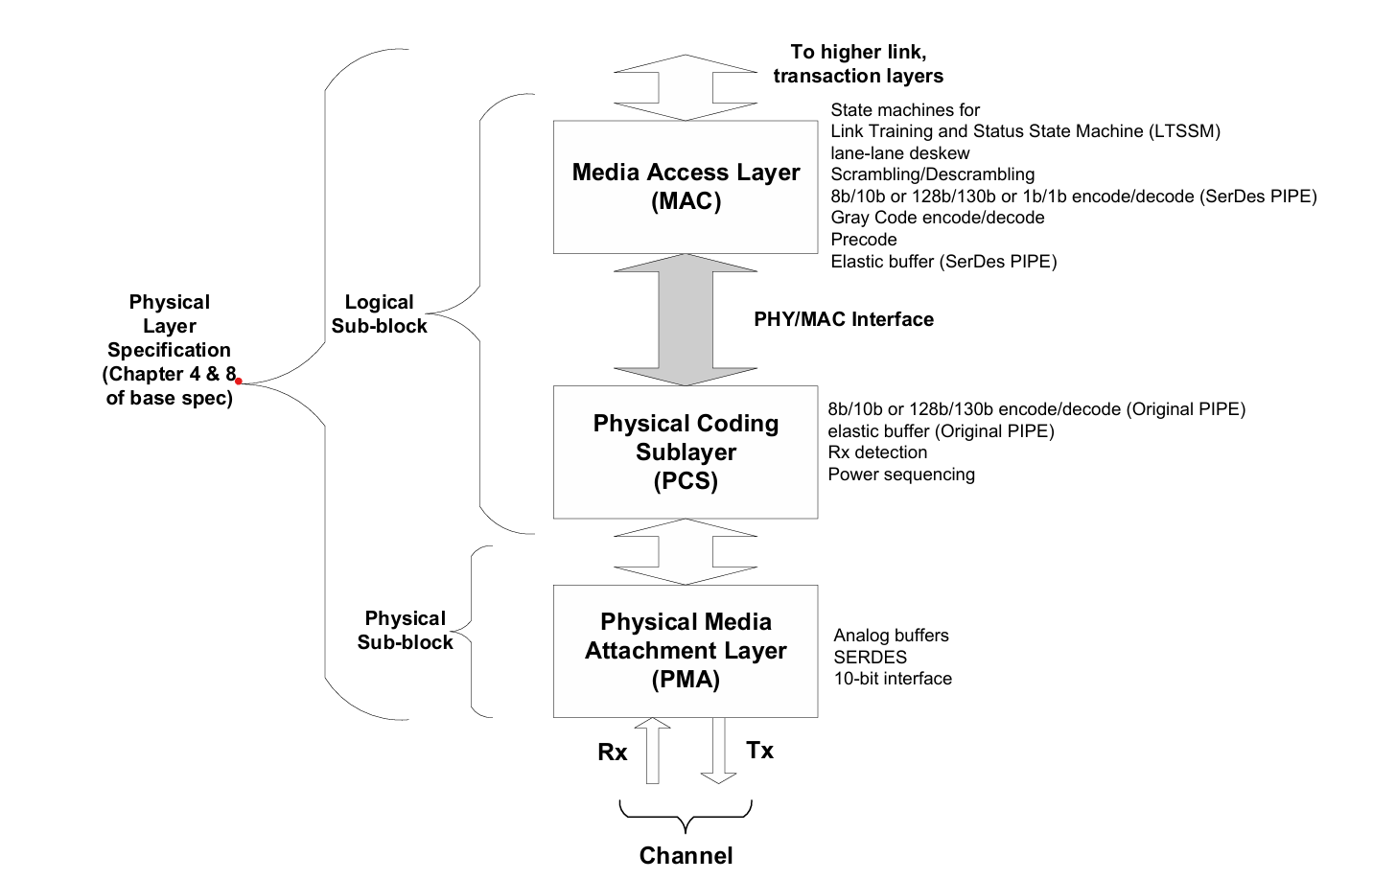
Partitioning PHY layer for PCIe

Slide 7
Short Reach Applications
PIPE Specification is
Designed for short channel / Short Reach (SR) applications
Common in Multi-Chip Package (MCP) designs
Enables up to 50% PCIe PHY power reduction

Slide 8
Power Optimization Mechanisms
Reduced PHY operating conditions (vendor-dependent):
Lower PHY supply voltage
Reduced Tx swing
Simplified clock recovery
Reduced receiver equalization (CTLE / DFE activity)
Optimized channel loss assumptions
Supported operating points advertised via:
ShortChannelPowerControlSettings
Supported Selected by MAC using:
ShortChannelPowerControl[1:0] (PIPE interface)

Slide 9
Configurable Pairs
Support for configurable Rx and Tx differential pairs was added in version 5.0 of the PIPE specification.
Supported lane combinations are one Rx pair and one Tx pair, two Tx pairs, or two Rx pairs; each combination shares a single set of PIPE per-lane signals.

Slide 10
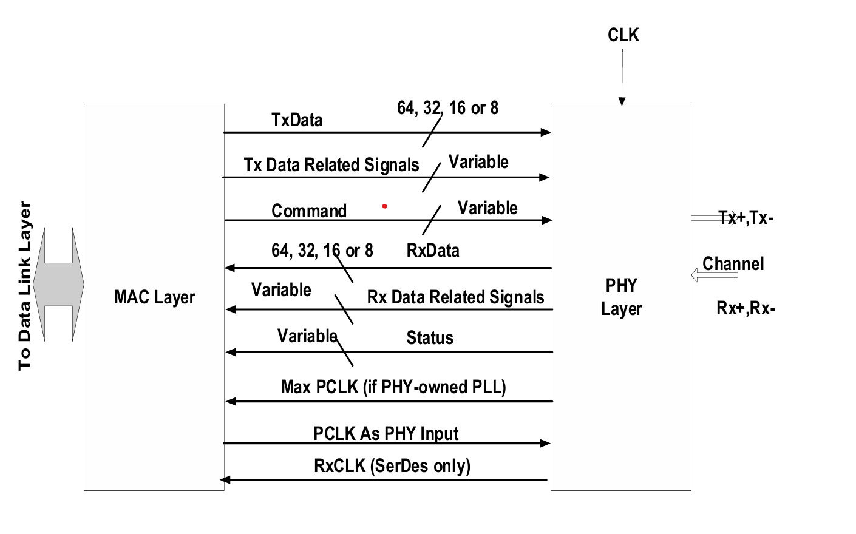
PHY/MAC Interface
Below shows the data and logical command and status signals between the PHY and the MAC layer for one Rx pair and one Tx pair combination.

Slide 11
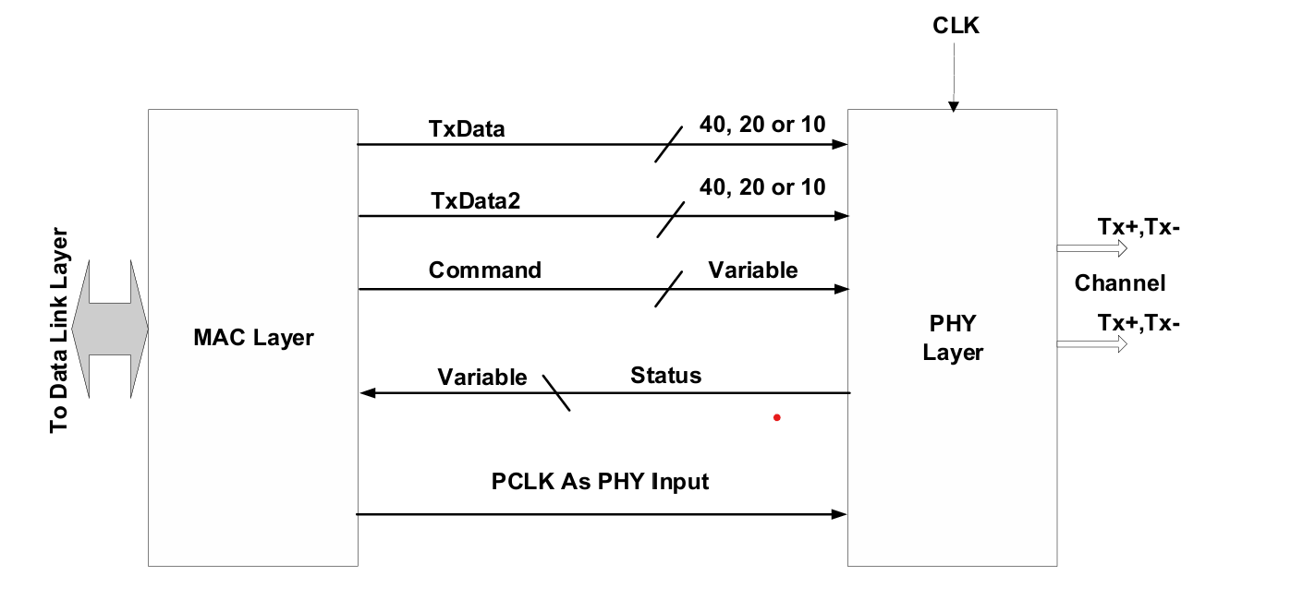
DPTX PHY/MAC Interface
Below show the data and command and status signals between the PHY and the MAC layer for the DisplayPort DPTX .

Slide 12
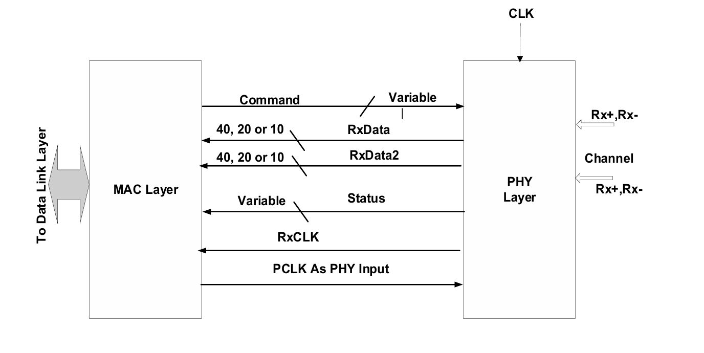
DPRX PHY/MAC Interface
show the data and command and status signals between the PHY and the MAC layer for the DisplayPort DPRX.

Slide 13
PCLK Rates and Data Width
Mode | PCLK | Original PIPE Datawidth(SerDes Datawidth) | TXDataValid and RXDatavalid Strobe Rate
2.5 GT/s | 4000 Mhz | 8 bits(10 bits) | 1 in 16 PCLKs
2.5 GT/s | 2000 Mhz | 8 bits(10 bits) | 1 in 8 PCLKs
2.5 GT/s | 1000 Mhz | 8 bits(10 bits) | 1 in 4 PCLKs
2.5 GT/s | 500 Mhz | 8 bits(10 bits) | 1 in 2 PCLKs
2.5 GT/s | 250 Mhz | 8 bits(10 bits) | N/A
2.5 GT/s | 250 Mhz | 16 bits(20 bits) | 1 in 2 PCLKs
2.5 GT/s | 500 Mhz | 16 bits(20 bits) | 1 in 4 PCLKs
2.5 GT/s | 125 Mhz | 16 bits(20 bits) | N/A
2.5 GT/s | 250 Mhz | 32 bits(40 bits) | 1 in 4 PCLKs
2.5 GT/s | 62.5 Mhz | 32 bits(40 bits) | N/A
2.5 GT/s | 62.5 Mhz | N/A (80 bits) | 1 in 2 PCLKs

Slide 14
MODE | PCLK | Original PIPE Datawidth(SerDes Datawidth) | TXDataValid and RXDatavalid Strobe Rate
5.0 GT/s | 4000 Mhz | 8 bits (10 bits) | 1 in 8 PCLKs
5.0 GT/s | 2000 Mhz | 8 bits (10 bits) | 1 in 4 PCLKs
5.0 GT/s | 1000 Mhz | 8 bits (10 bits) | 1 in 2 PCLKs
5.0 GT/s | 500 Mhz | 8 bits (10 bits) | N/A
5.0 GT/s | 500 Mhz | 16 bits (20 bits) | 1 in 2 PCLKs
5.0 GT/s | 250 Mhz | 16 bits (20 bits) | N/A
5.0 GT/s | 250 Mhz | 32 bits (40 bits) | 1 in 2 PCLKs
5.0 GT/s | 125 Mhz | 32 bits (40 bits) | N/A
5.0 GT/s | 125 Mhz | N/A (80 bits) | 1 in 2 PCLKs
5.0 GT/s | 62.5 Mhz | N/A (80 bits) | N/A

Slide 15
mode | PCLK | Original PIPE Datawidth(SerDes Datawidth) | TXDataValid and RXDatavalid Strobe Rate
8.0 GT/s | 4000 Mhz | 8 bits(10 bits) | 1 in 4 PCLKS
8.0 GT/s | 2000 Mhz | 8 bits(10 bits) | 1 in 2 PCLKS
8.0 GT/s | 1000 Mhz | 8 bits(10 bits) | N/A
8.0 GT/s | 1000 Mhz | 16 bits(20 bits) | 1 in 2 PCLKS
8.0 GT/s | 500 Mhz | 16 bits(20 bits) | N/A
8.0 GT/s | 500 Mhz | 32 bits(40 bits) | 1 in 2 PCLKS
8.0 GT/s | 250 Mhz | 16 bits(20 bits) | N/A
8.0 GT/s | 250 Mhz | N/A (80 bits) | 1 in 2 PCLKS
8.0 GT/s | 125 Mhz | N/A (80 bits) | N/A
16.0 GT/s | 4000 Mhz | 8 bits(10 bits) | 1 in 2 PCLKS
16.0 GT/s | 2000 Mhz | 8 bits(10 bits) | N/A
16.0 GT/s | 1000 Mhz | 16 bits(20 bits) | N/A

Slide 16
MODE | PCLK | Original PIPE Datawidth(SerDes Datawidth | TXDataValid and RXDatavalid Strobe Rate
16.0 GT/s | 1000 Mhz | 32 bits (40 bits) | 1 in 2 PCLKs
16.0 GT/s | 500 Mhz | 32 bits (40 bits) | N/A
16.0 GT/s | 250 Mhz | N/A (80 bits) | N/A
32 GT/s | 4000 Mhz | 8 bits (10 bits) | N/A
32 GT/s | 2000 Mhz | 16 bits (20 bits) | N/A
32 GT/s | 1000 Mhz | 32 bits (40 bits) | N/A
32 GT/s | 500 Mhz | N/A (80 bits) | N/A
64 GT/s | 4000 Mhz | N/A (20 bits) | N/A
64 GT/s | 2000 Mhz | N/A (40 bits) | N/A
64 GT/s | 1000 Mhz | N/A (80 bits) | N/A
128 GT/s | 4000 Mhz | N/A (40 bits) | N/A
128 GT/s | 2000 Mhz | N/A (80 bits) | N/A

Slide 17
PCIe Mode (SerDes only)
Mode | RXCLK | Data Width
2.5 GT/s | 250 Mhz | 10 bits
2.5 GT/s | 125 Mhz | 20 bits
2.5 GT/s | 62.5 Mhz | 40 bits
2.5 GT/s | 31.25 Mhz | 80 bits
5.0 GT/s | 500 Mhz | 10 bits
5.0 GT/s | 250 Mhz | 20 bits
5.0 GT/s | 125 Mhz | 40 bits
5.0 GT/s | 62.5 Mhz | 80 bits
8.0 GT/s | 1000 Mhz | 10 bits
8.0 GT/s | 500 Mhz | 20 bits
8.0 GT/s | 250 Mhz | 40 bits
8.0 GT/s | 125 Mhz | 80 bits

Slide 18
mode | RxCLK | DataWidth
32 GT/s | 4000 Mhz | 10 bits
32 GT/s | 2000 Mhz | 20 bits
32 GT/s | 1000 Mhz | 40 bits
32 GT/s | 500 Mhz | 80 bits
64 GT/s | 4000 Mhz | 20 bits
64 GT/s | 2000 Mhz | 40 bits
64 GT/s | 1000 Mhz | 80 bits
128 GT/s | 4000 Mhz | 40 bits
128 GT/s | 2000 Mhz | 80 bits
128 GT/s | 1000 Mhz | 160 bits

Slide 19
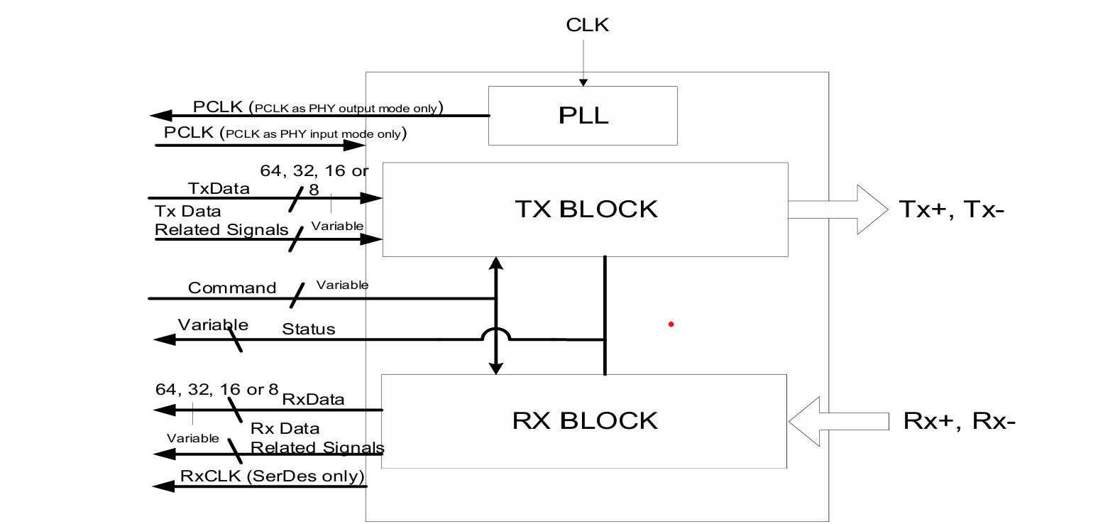
PHY Functional block diagrams
PHY Functional block diagram for Tx+Rx Usage

Slide 20
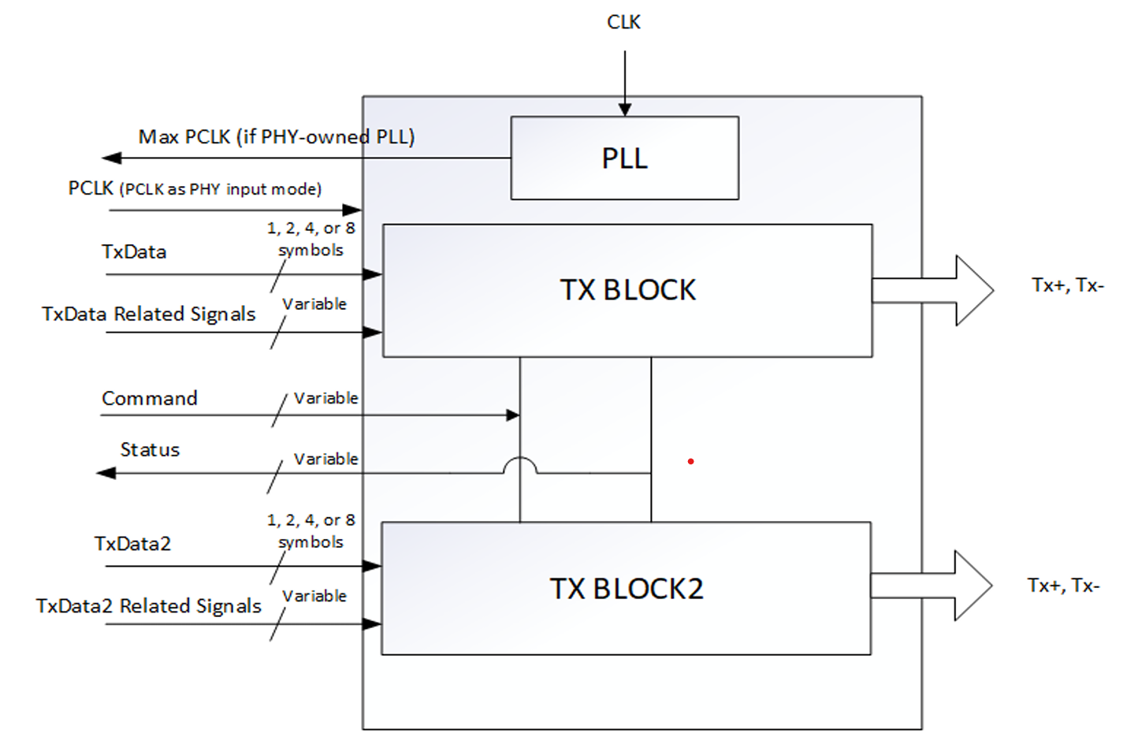
PHY Functional Diagram for Tx+Tx Usage Case

Slide 21
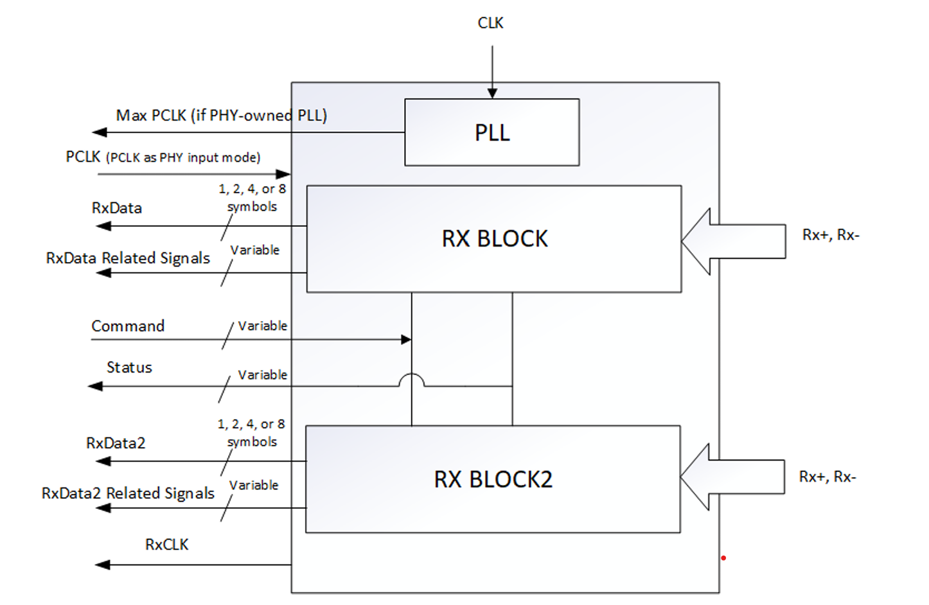
PHY Functional Diagram for Rx+Rx Usage Case

Slide 22
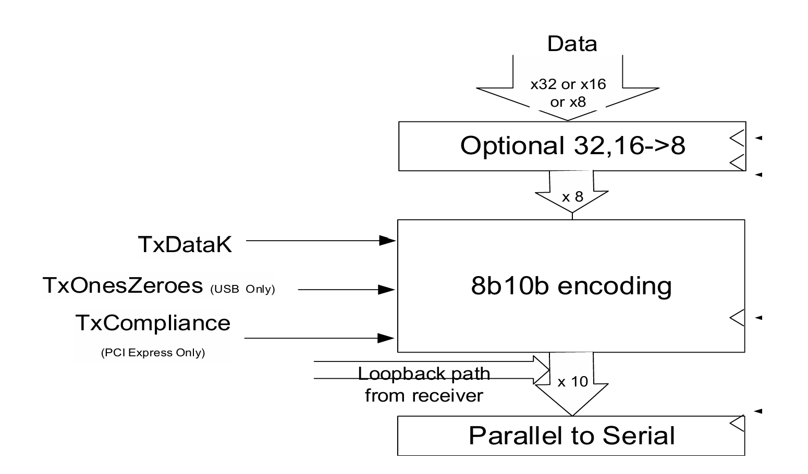
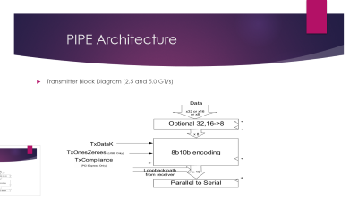
PIPE Architecture
Transmitter Block Diagram (2.5 and 5.0 GT/s)

Slide 23
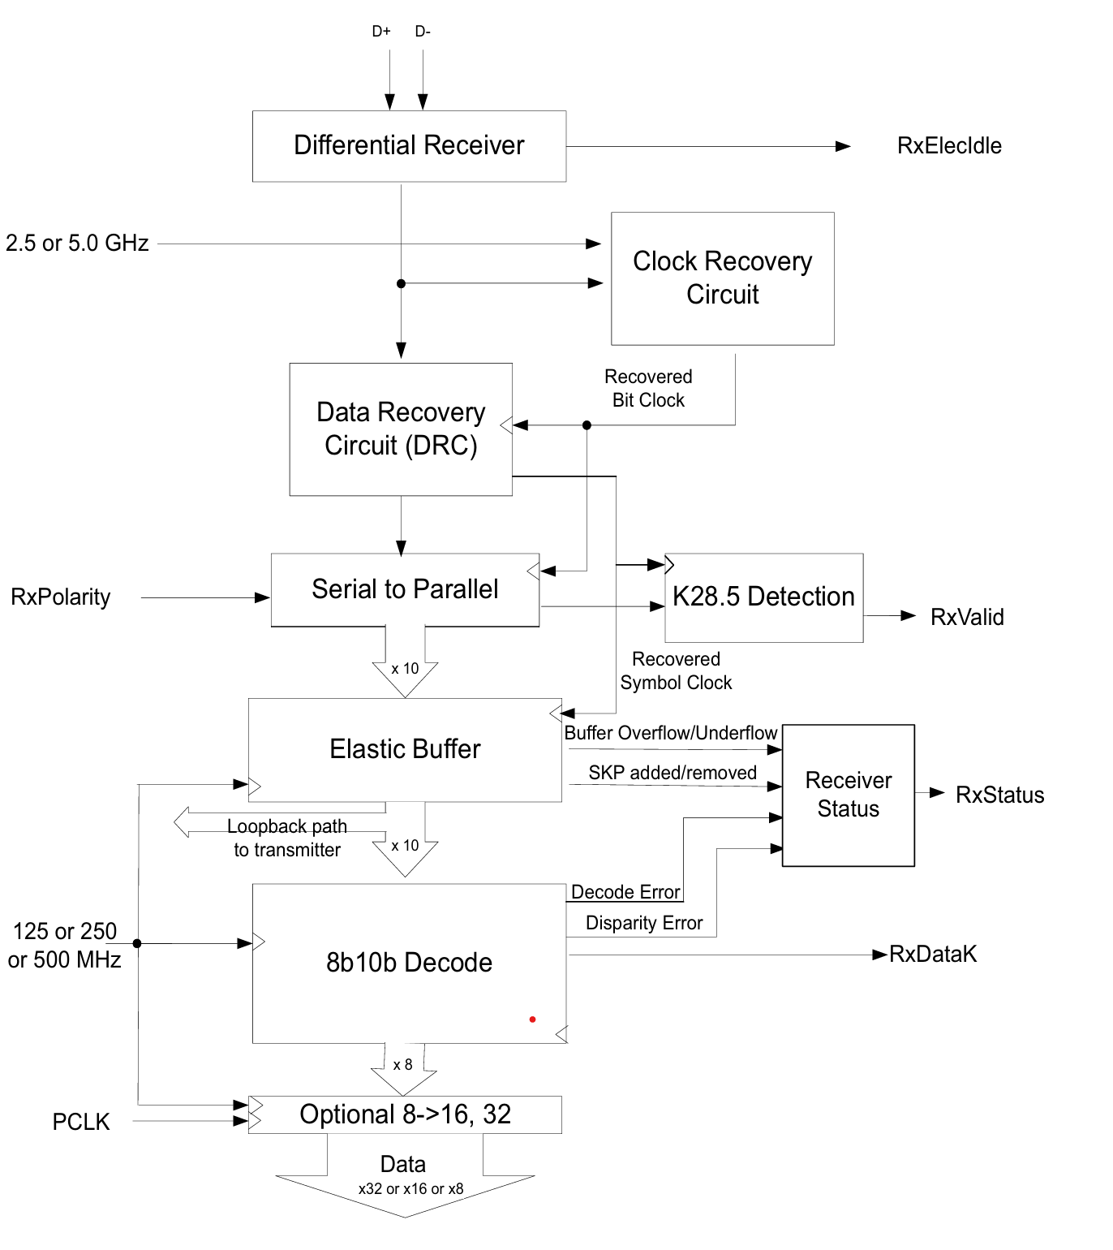
Receiver Block Diagram (2.5 and 5.0 GT/s)

Slide 24
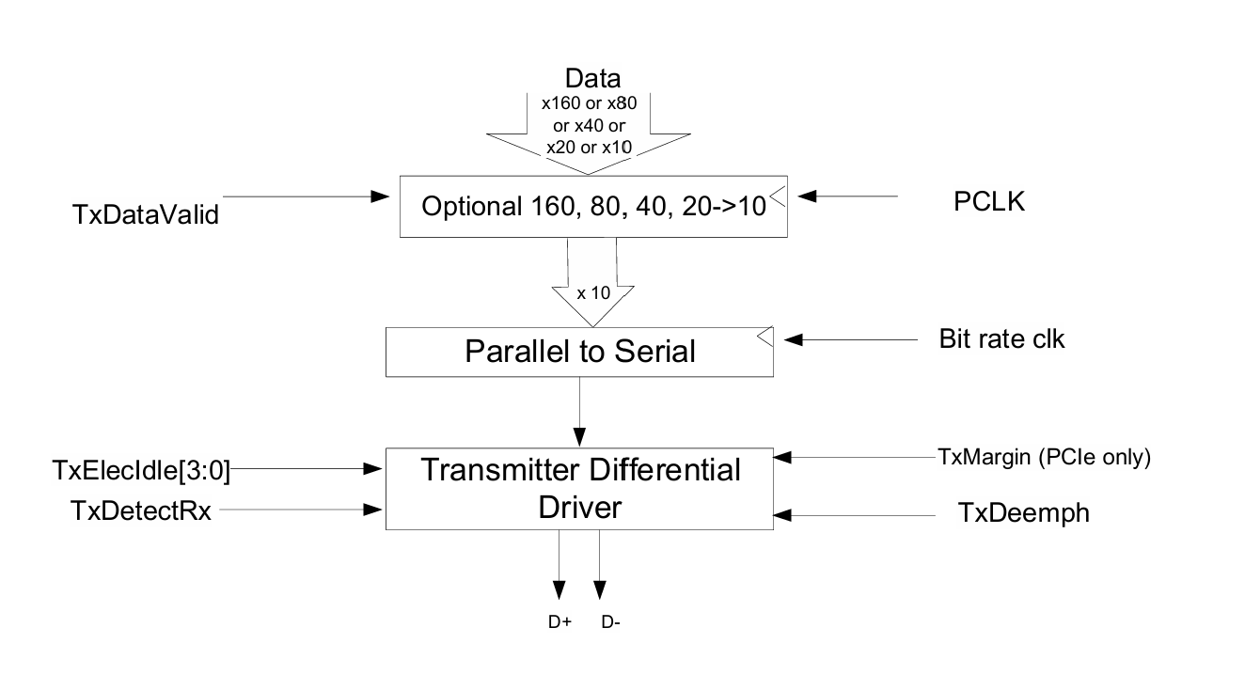
SerDes Architecture
With the SerDes architecture, the PHY implements minimal digital logic compared to the original PIPE architecture.
SerDes Architecture: PHY Transmitter Block Diagram.

Slide 25
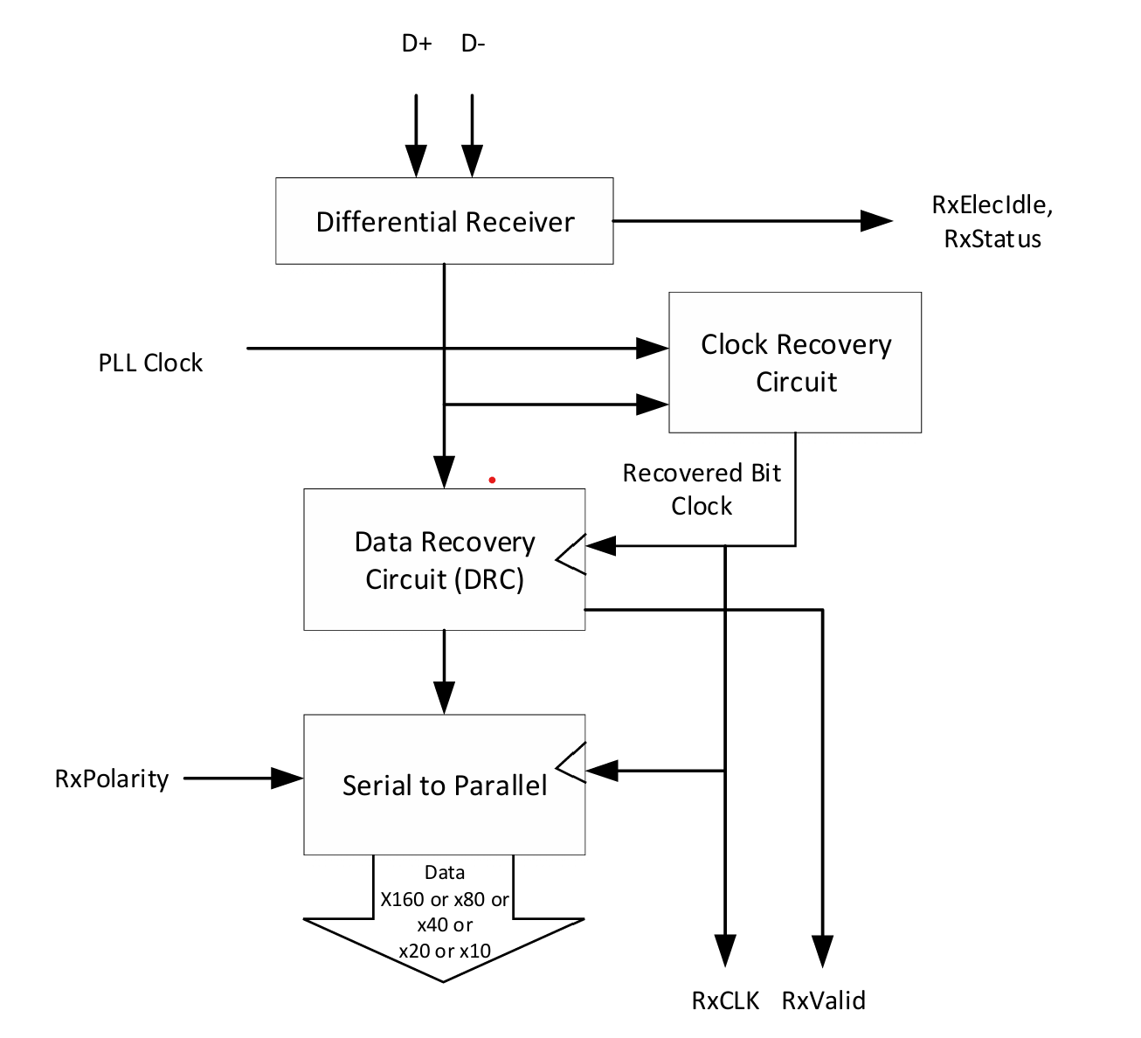
SerDes Architecture: PHY Receiver Block Diagram

Slide 26
Advantages & Disadvantages
Advantages
Standardized Interface
PHY abstraction
Scalability across generations
Design reuse and multi lane support
Disadvantages
High power consumption
High area
Clocking complexity (PIPE clk,SerDes clk,ref clk)

Slide 27


